Slide 1

AEROSENSE
An Al air quality monitoring system that predicts pollution levels in real-time and provides actionable insights to safeguard residents' health.
Team Name : Zoeo
Padmajaa Sridhar - Shiv Nadar University Chennai
Jayashre K - Shiv Nadar University Chennai
Harshitha R S - Shiv Nadar University Chennai
Mridulla.K.Madhu - Shiv Nadar University Chennai
Notes:
Line spacing + Page numbers

Slide 2

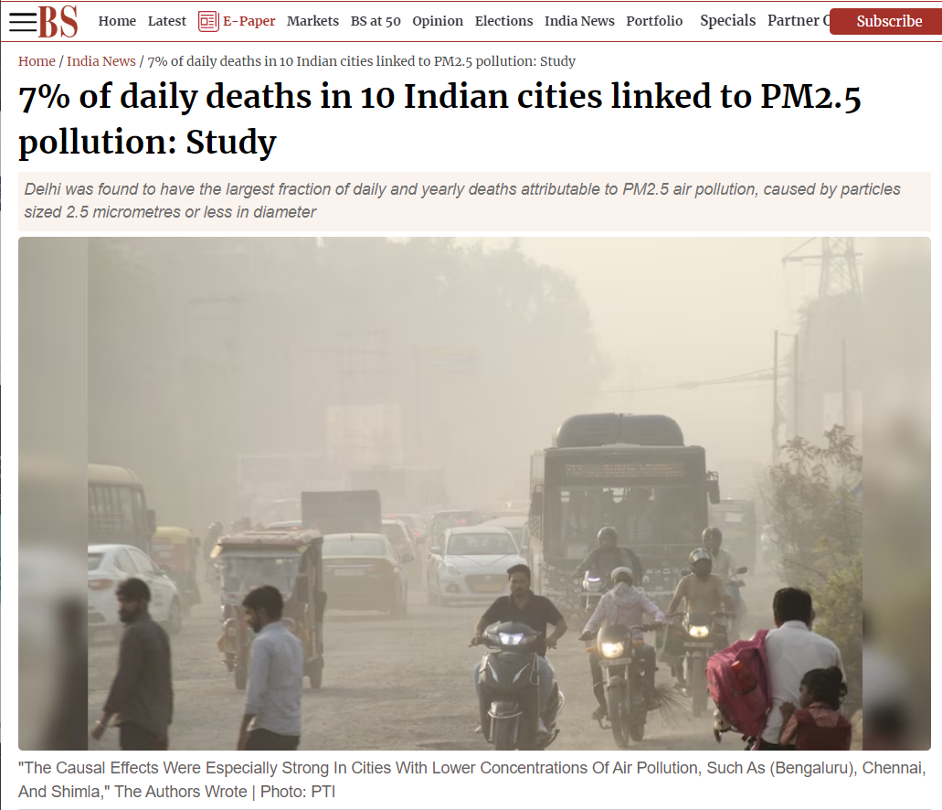

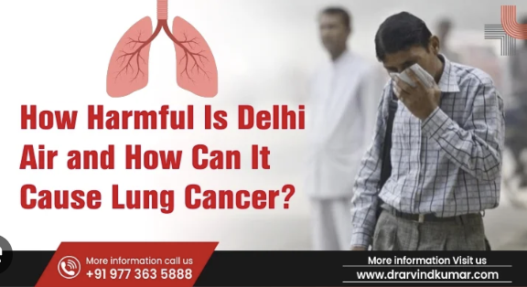
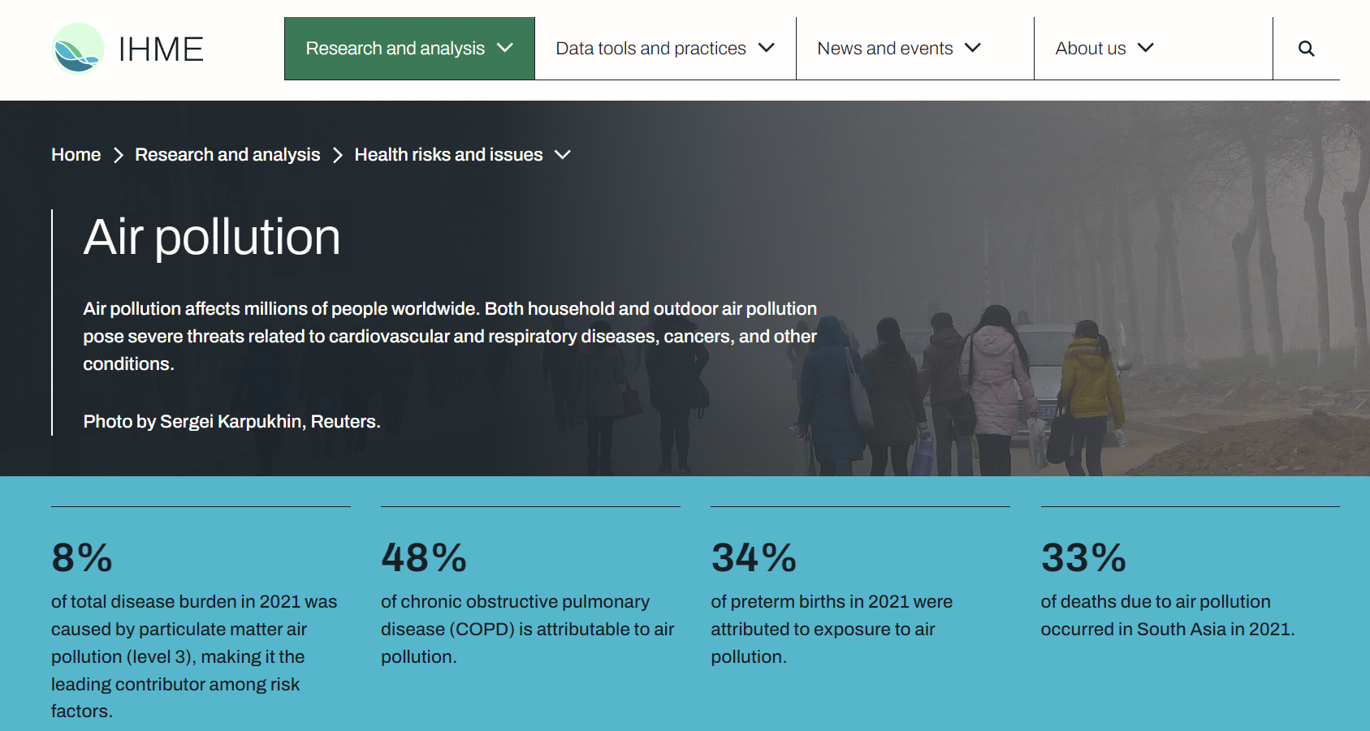

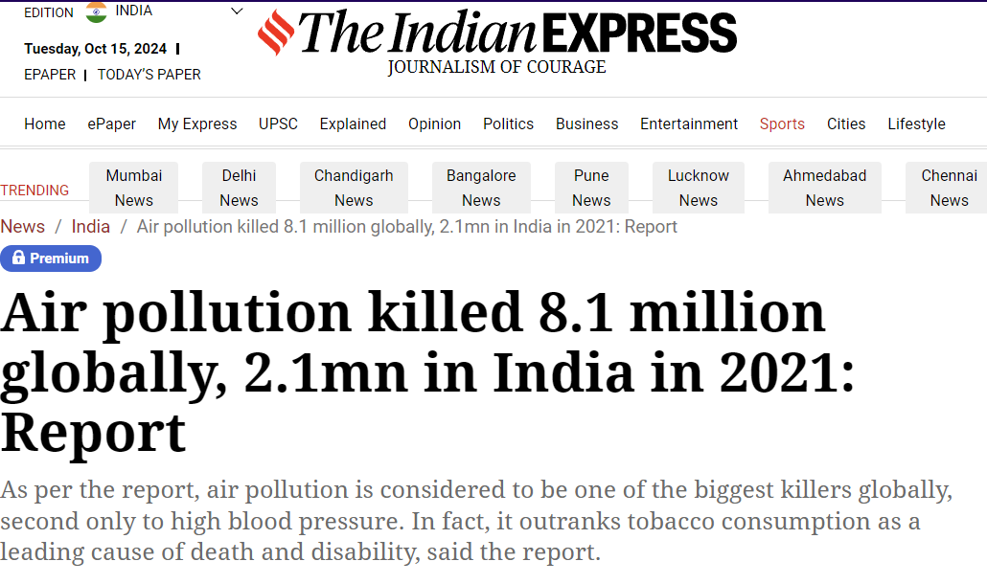
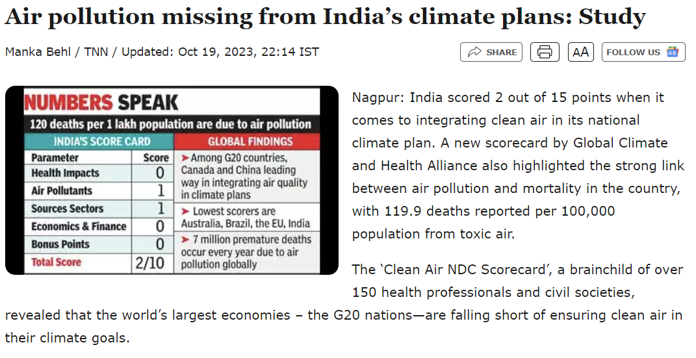
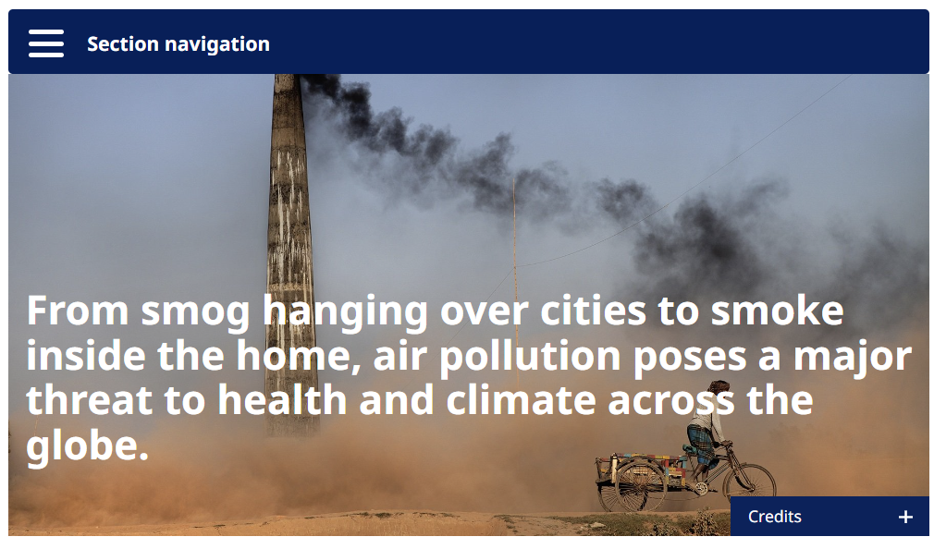


Slide 3
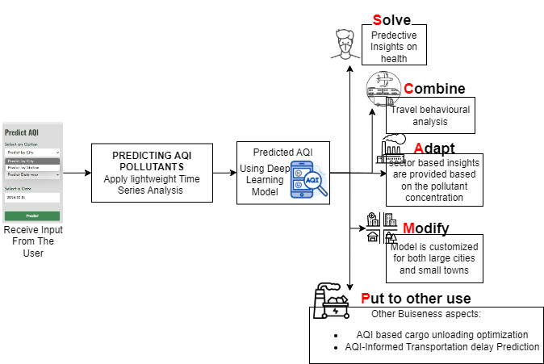
IDEA/SOLUTION:
MODEL ARCHITECTURE:
UNIQUE VALUE POINTS :
Real-time insights into rising levels of specific pollutants
For present-day AQI levels, we inform users about potential side effects.
In case of an Upward trend in AQI series prediction, its
relevant pollutants are found and their respective reason
to increase are found and informed.
01
By providing actionable insights and recommendations, we enable informed decisions that lead to cleaner air, healthier populations, and reduced healthcare costs.
Real-time Air Quality Monitoring: Provides live data on air pollution levels across cities, for timely health and environmental action.
Pollutant-Specific Predictions: Predicts concentrations of harmful pollutants like PM2.5, PM10, and NO2, offering deeper insights beyond a generic AQI, enabling targeted pollutant reduction strategies.
PROBLEM RESOLUTION:
Sustainable Decision-Making: Supports city planners with data-driven strategies, enabling sustainable transportation and long-term pollution reduction efforts.
Our platform helps transform complex data into User-Friendly Visuals

Slide 4
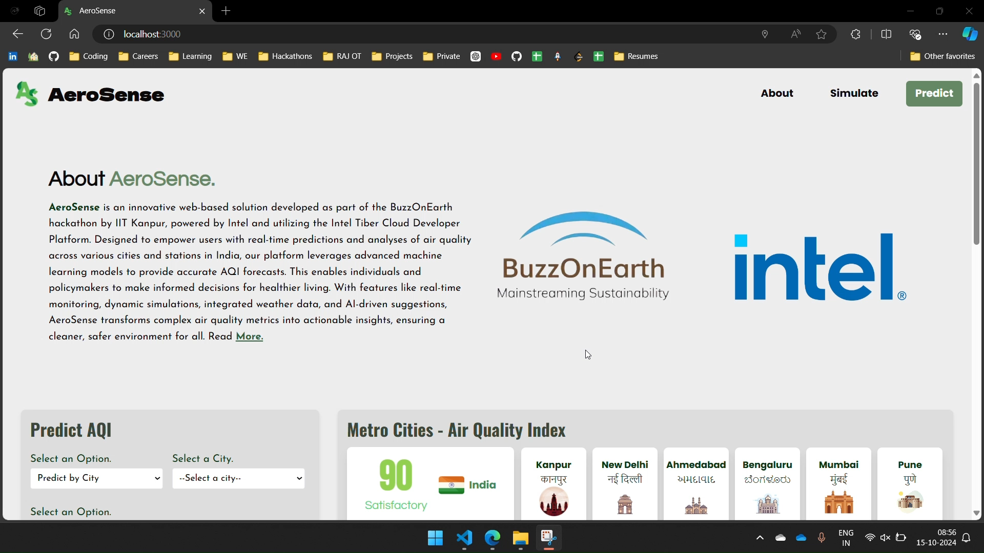
PROTOTYE DEMO
02

Slide 5
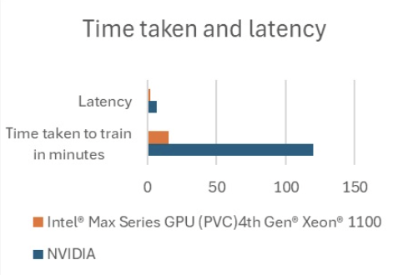
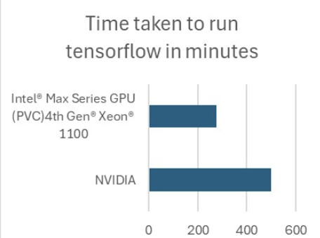
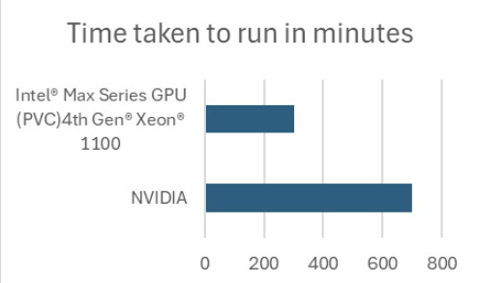
INTEL INTEGRATION:
03
Intel® Max Series GPU (PVC) on 4th Gen Intel® Xeon® processors – 1100 series (1x)
Efficient RAM utilization saved the Toll in Battery.
Dynamic memory allocation – helped us solve the ‘memory insufficient’ issue faced during Batch sequence processing for LSTM.
There was no compromise in performance even with additional data.
Intel Extension for TensorFlow
Helped in faster Training of data models
Intel OpenVino
Helps speedup and optimise AI models (LLM)

Slide 6
AEROSENSE
04
BUSINESS APPROACH:
CARGO : Revolutionize cargo unloading with our AQI monitoring solution, reducing pollution spikes and safeguarding coastal communities' health during port operations.
Informed Delay Prediction: Alerting users to potential disruptions and ensuring safer journeys
.A United Front: Partnering with local governments, NGOs, and communities, Aerosense quickly identifies and addresses increased pollutant concentrations for faster pollution control.
FUTURE SCOPE:
Secure Database Integrity: Using SHA-256 algorithm in bash script, to provide integrity to the newly predicted AQI dataset.
Reinforcement learning to continuously enhance predictions and adapt to changing environmental conditions
SUMMARY :
Actionable Insights: Enables informed decisions for cleaner air, healthier populations, and reduced healthcare costs.
Real-time Air Quality Monitoring: Provides live data on air pollution levels across cities for prompt health and environmental responses.
Data-Driven Recommendations: Utilizing LLM personalized tips to reduce exposure and counter measures.
Pollutant-Specific Predictions: Offers predictions for harmful pollutants (PM2.5, PM10, NO2), facilitating targeted reduction strategies.
Sustainable Decision-Making: Assists city planners with data-driven strategies for sustainable transportation and long-term pollution management.
Technical Feasibility: Scalable AI models (LSTM, CNN) and cloud infrastructure for reliable real-time predictions.

Slide 7
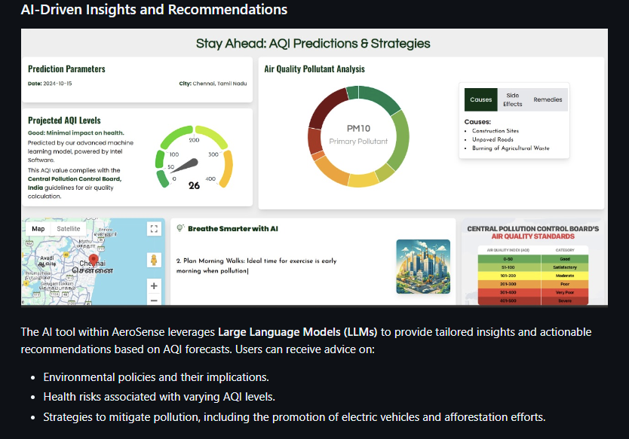
GIT
05
REFERENCES:
Aram, S.A., Nketiah, E.A., Saalidong, B.M. et al. Machine learning-based prediction of air quality index and air quality grade: a comparative analysis. Int. J. Environ. Sci. Technol. 21, 1345–1360 (2024). https://doi.org/10.1007/s13762-023-05016-2
Mishra, A., Gupta, Y. Comparative analysis of Air Quality Index prediction using deep learning algorithms. Spat. Inf. Res. 32, 63–72 (2024). https://doi.org/10.1007/s41324-023-00541-1
K., K., S.K., A., R., D. et al. Integrating machine learning techniques for Air Quality Index forecasting and insights from pollutant-meteorological dynamics in sustainable urban environments. Earth Sci Inform 17, 3733–3748 (2024). https://doi.org/10.1007/s12145-024-01382-8
https://github.com/fromjyce/AeroSense

